Slide 1
Grammar in Module 2

Slide 2
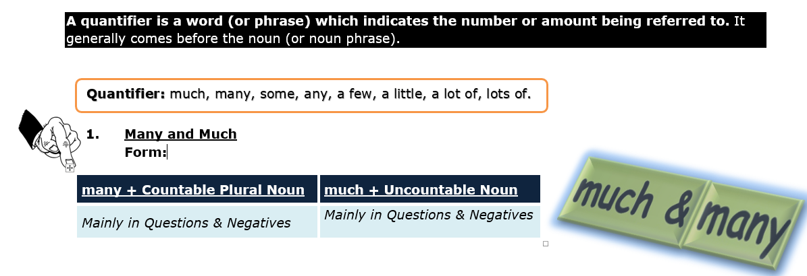
Quantifiers

Slide 3
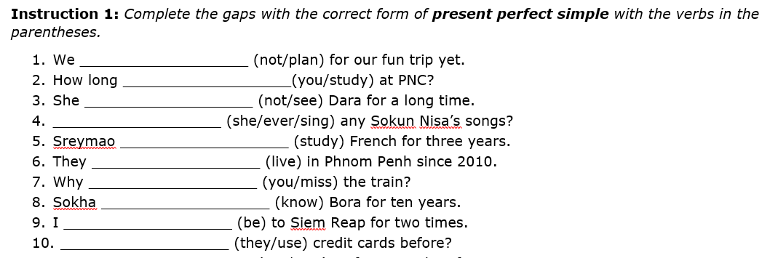
Present Perfect
Indefinite past
I have been to England for three times
She has already had breakfast.
Has Sokha met Dara yet?
Unfinished past
They have studied at PNC for two years.
Sokchan hasn’t met Borey since 2018.

Slide 4
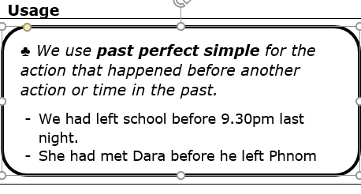
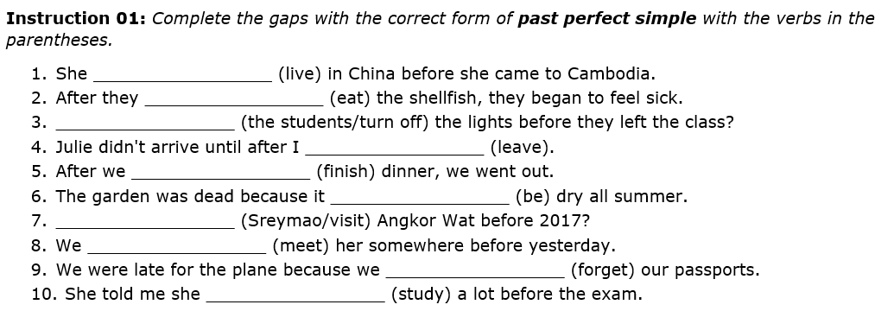
Past Perfect

Slide 5
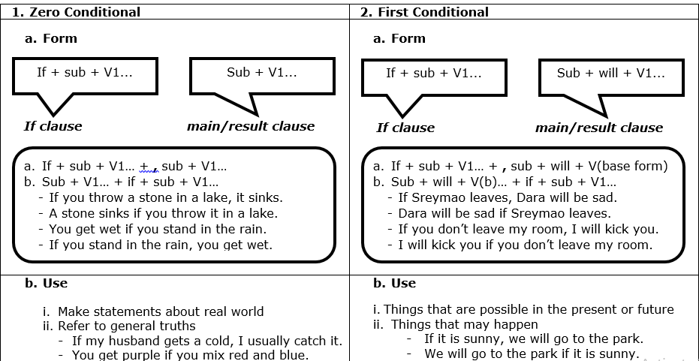
Conditionals(Zero & first)

Slide 6
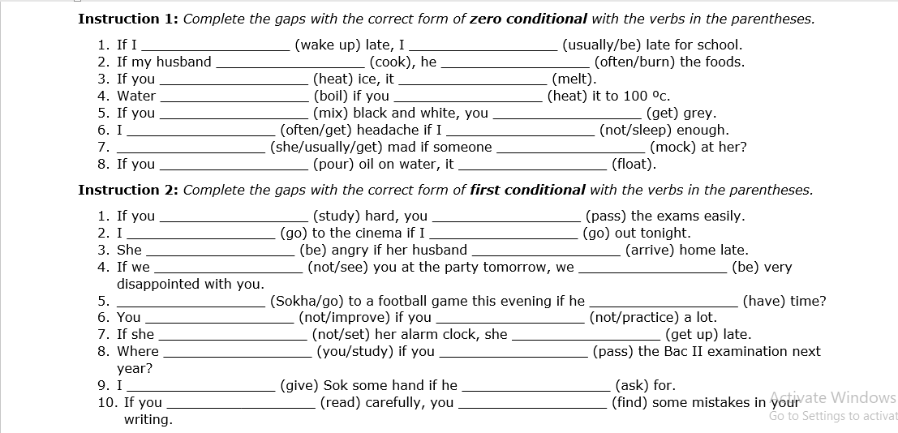

Slide 7
Comparative and Superlative

Slide 8
Present simple and Present Progressive

Slide 9
Past simple and Present Perfect

Slide 10
Past simple and Past Progressive

